Slide 1
A Plane Idea
Rory Ulmer, Ben Rogers, Matt Rogers

Slide 2
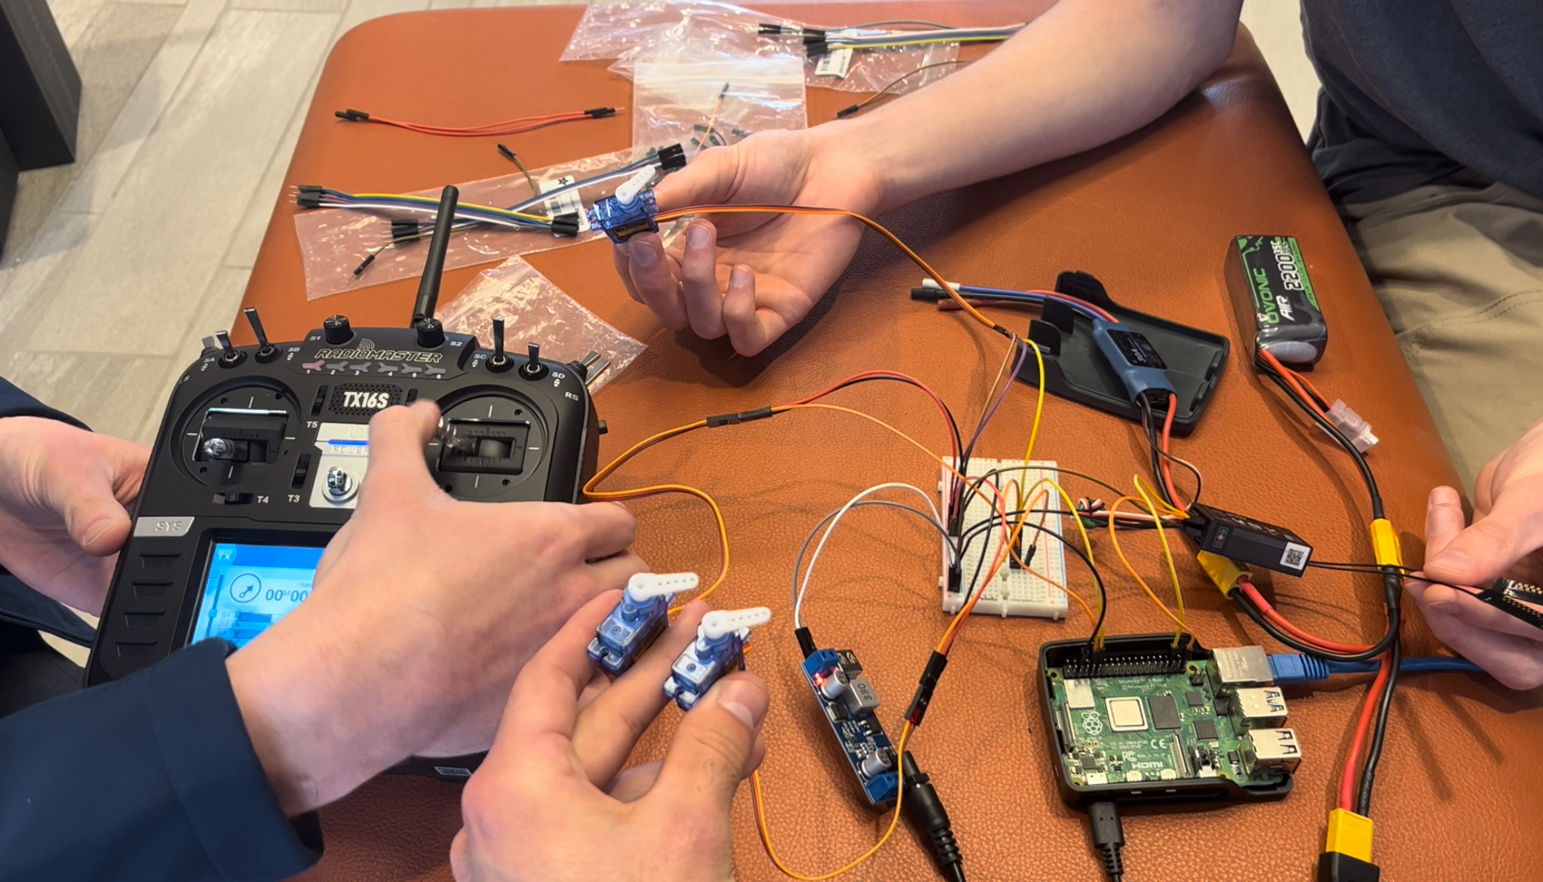
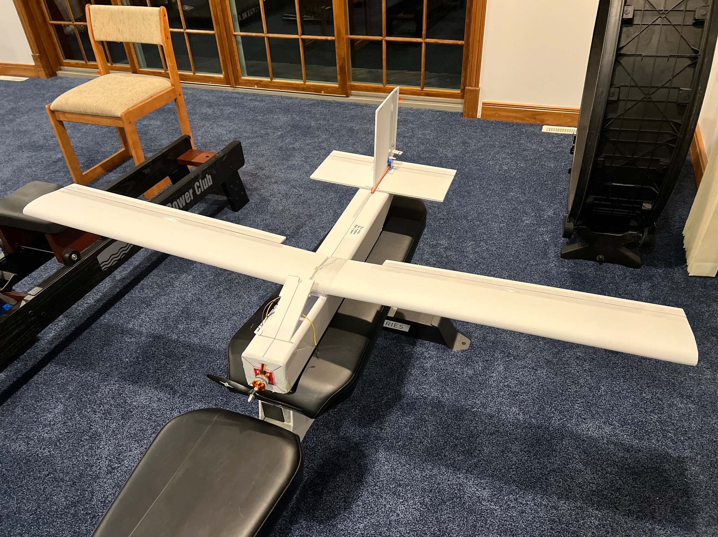

Slide 3
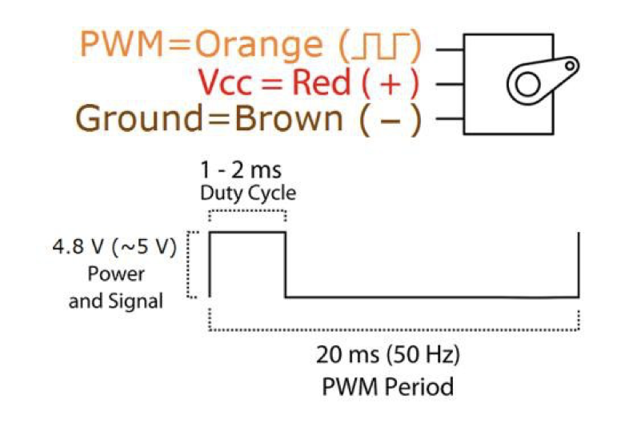
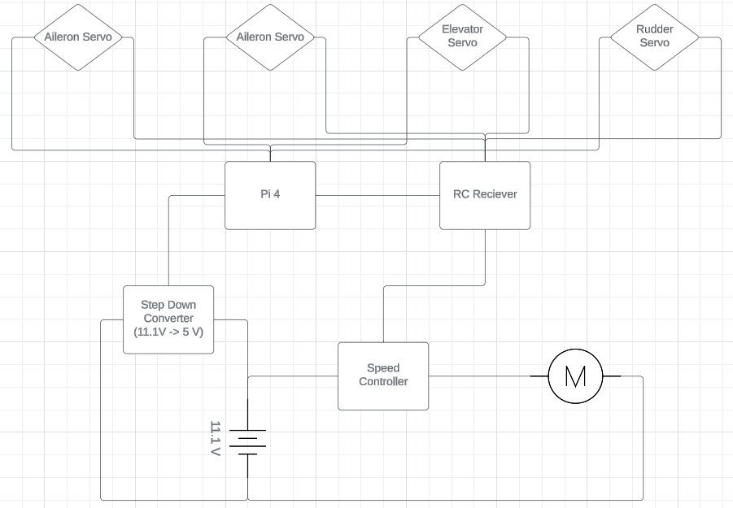
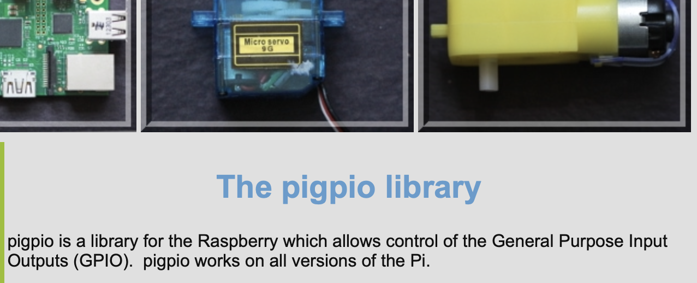
https://abyz.me.uk/rpi/pigpio/index.html

Slide 4


Slide 5

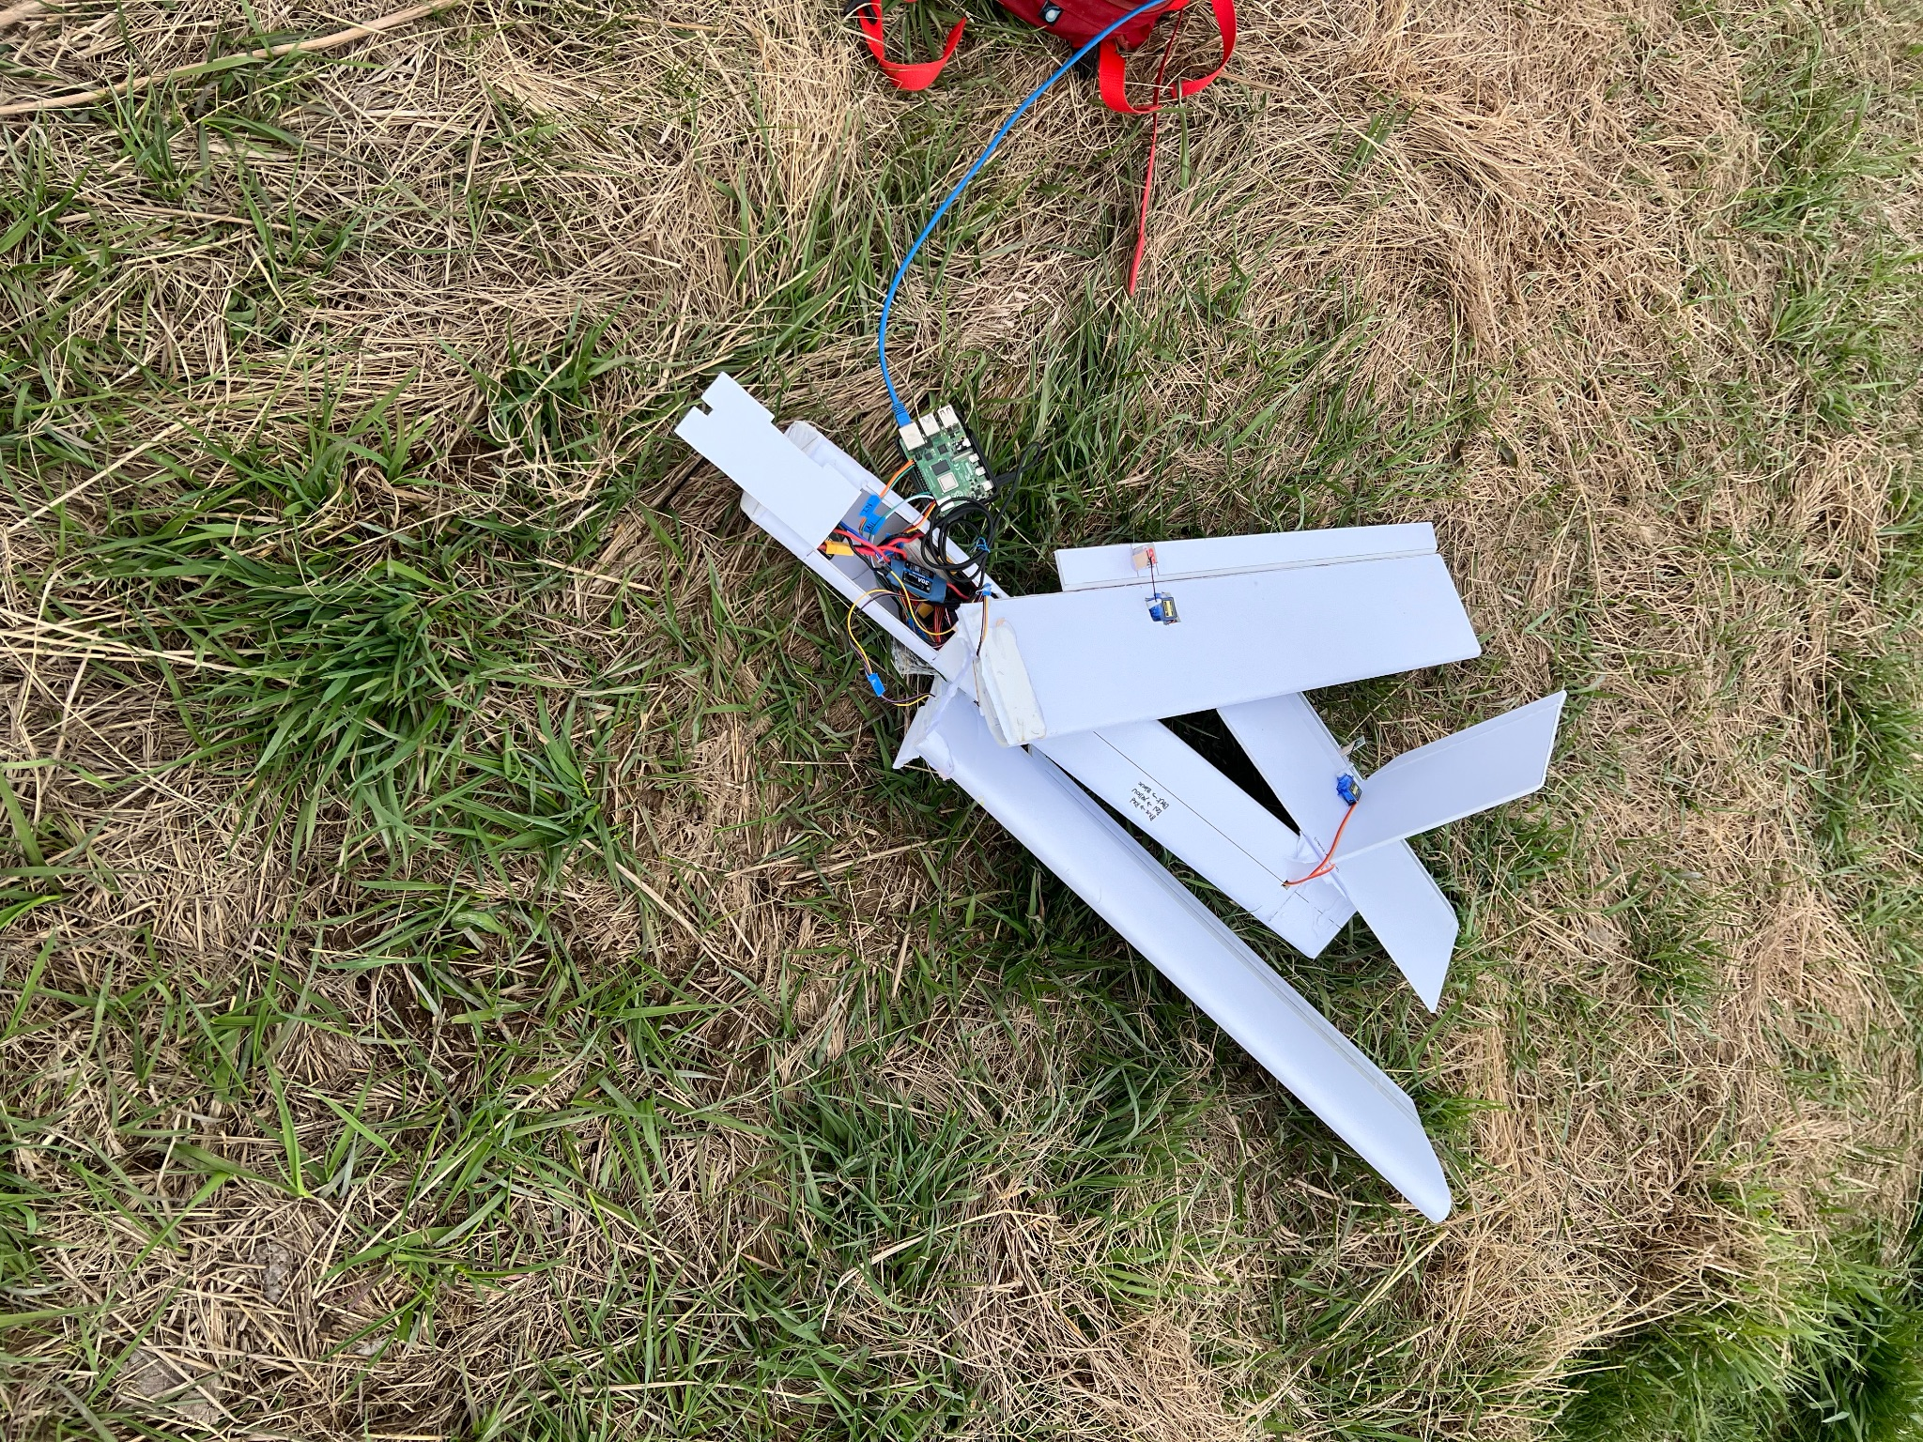
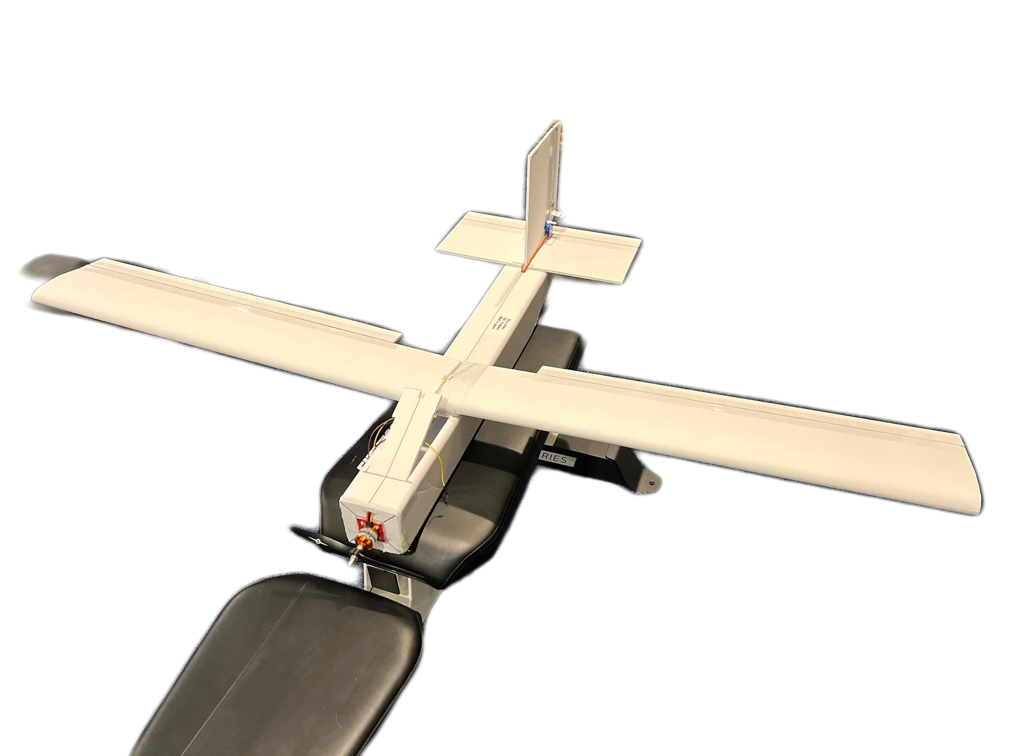
https://www.shutterstock.com/image-vector/spooky-tombstone-vector-illustration-gravestone-halloween-2241910357

